Slide 1
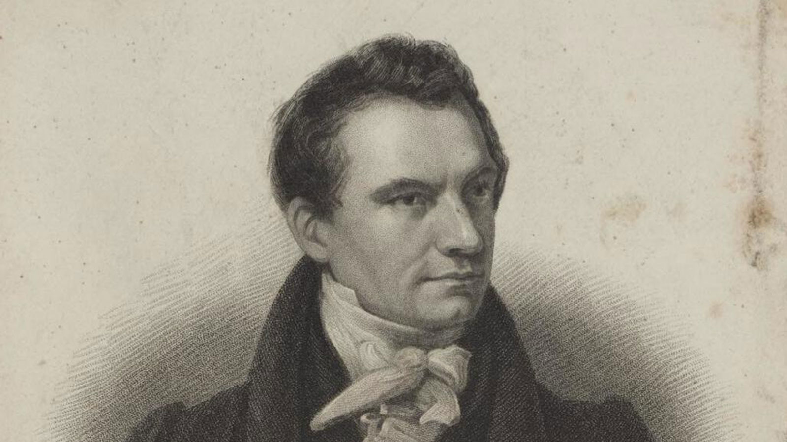
Who Invented Computer and When?
Charles Babbage
(Father of Computers)
1830s

Slide 2
What is a Computer?
A computer is an electronic device that takes input (data), processes it using instructions (programs), stores it, and gives output.
Takes input (data or instructions)
Processes the data
Gives output (meaningful results)

Slide 3
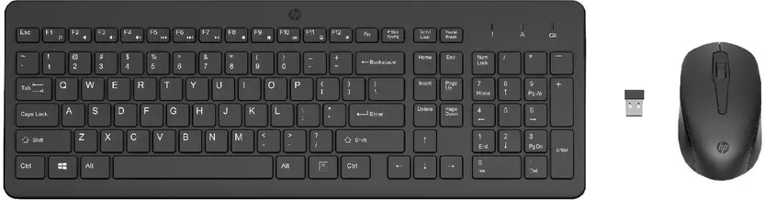
INPUT
Mouse
Keyboard

Slide 4
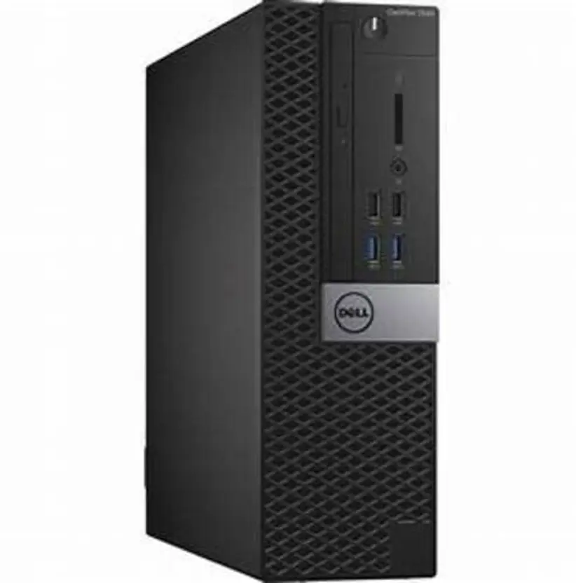
PROCESSES
CPU
CENTRAL PROCESSING UNIT

Slide 5
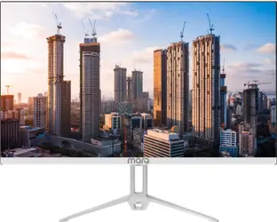
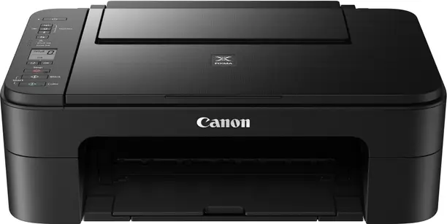
OUTPUT
Monitor
Printer

